Slide 1
Time card process

Slide 2
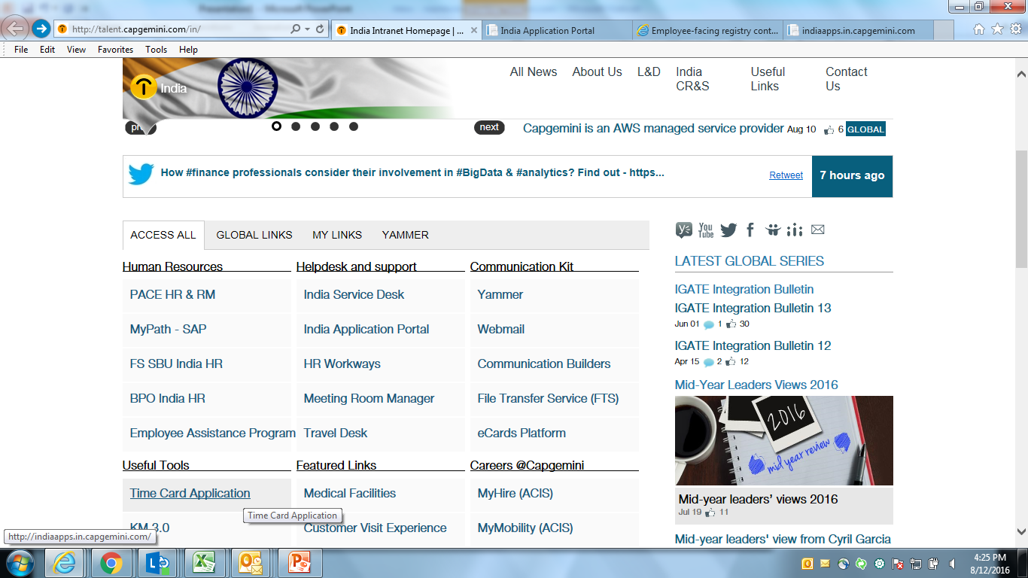
Link to access timecard
http://talent.capgemini.com/in/

Slide 3
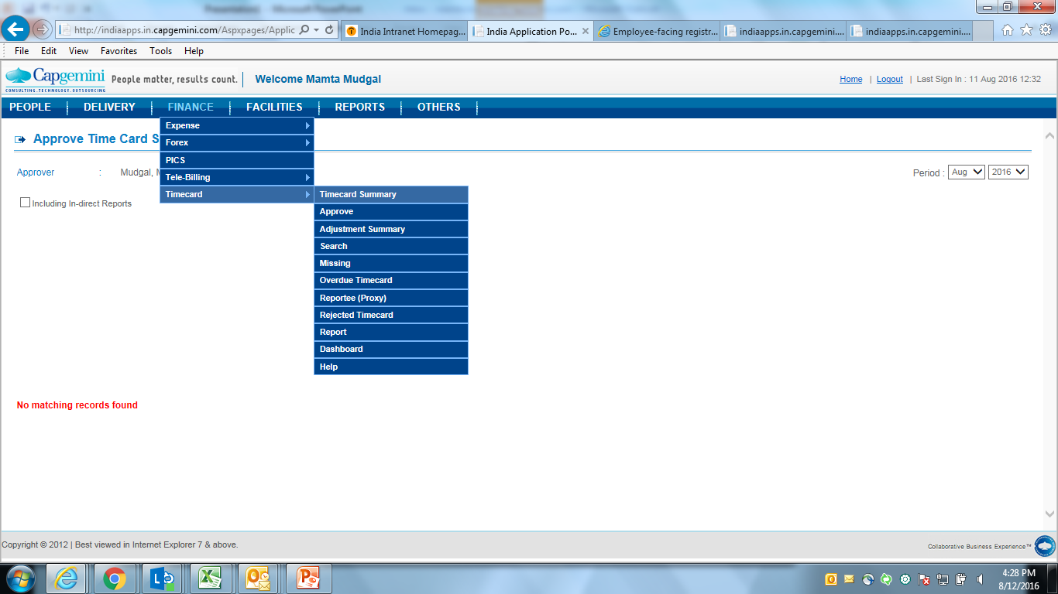
Timecard Entry screen
Click on Finance- Timecard- Timecard summary fill timesheet

Slide 4
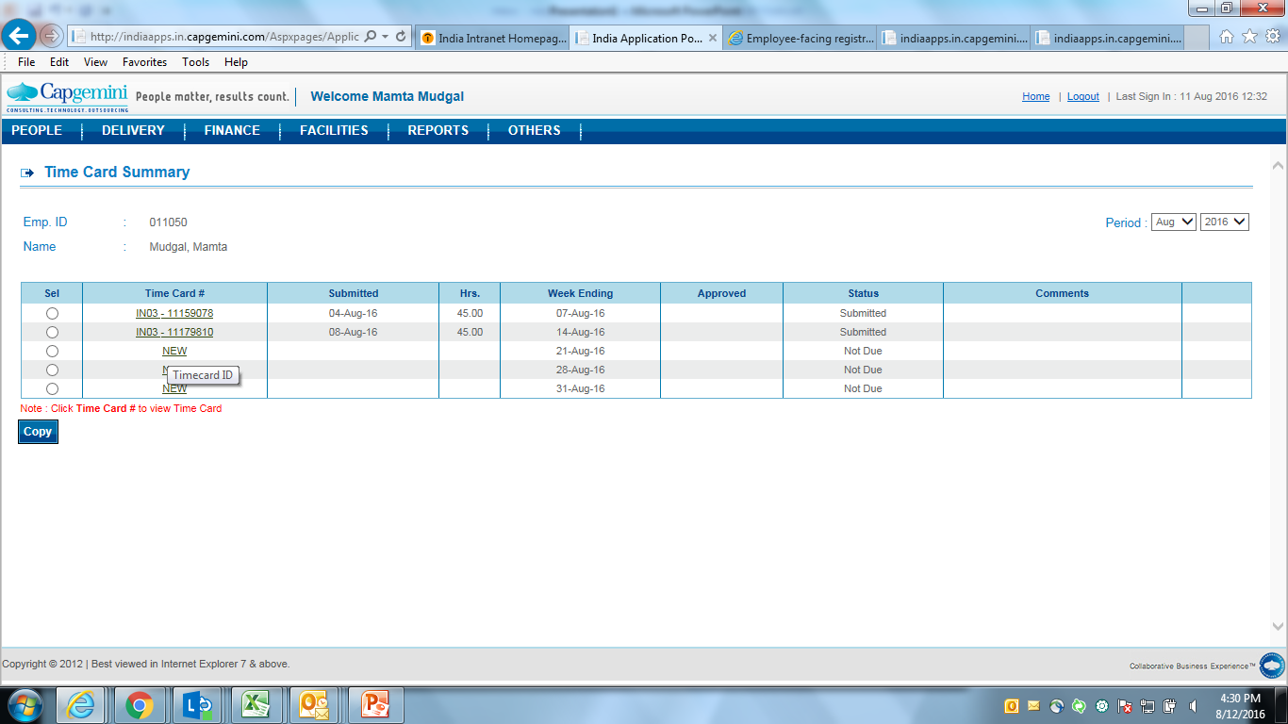
Timecard Entry Screen
Click on the week for which timecard need to filled in.

Slide 5
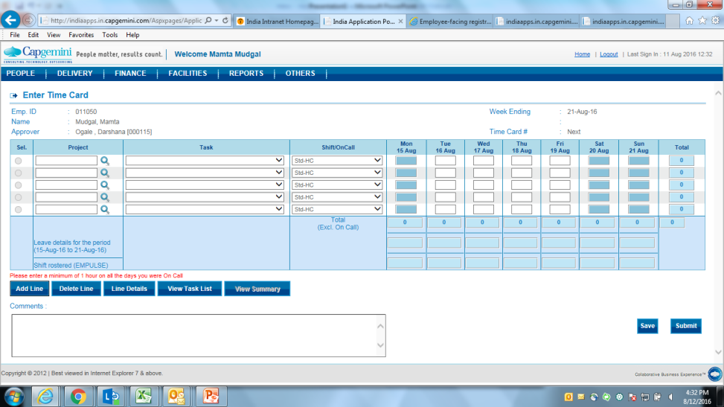
Timecard Entry Screen
Please enter project code:- 100311752.
The Task to be selected should be NBT.
Hours to be filled is 9 hours and submit the timesheet.

Slide 6
Timecard Entry Screen
If want to update leave. Apply in PACE first.
Once it approved, select Project Name as leave and update 9 hours and submit

